Slide 1

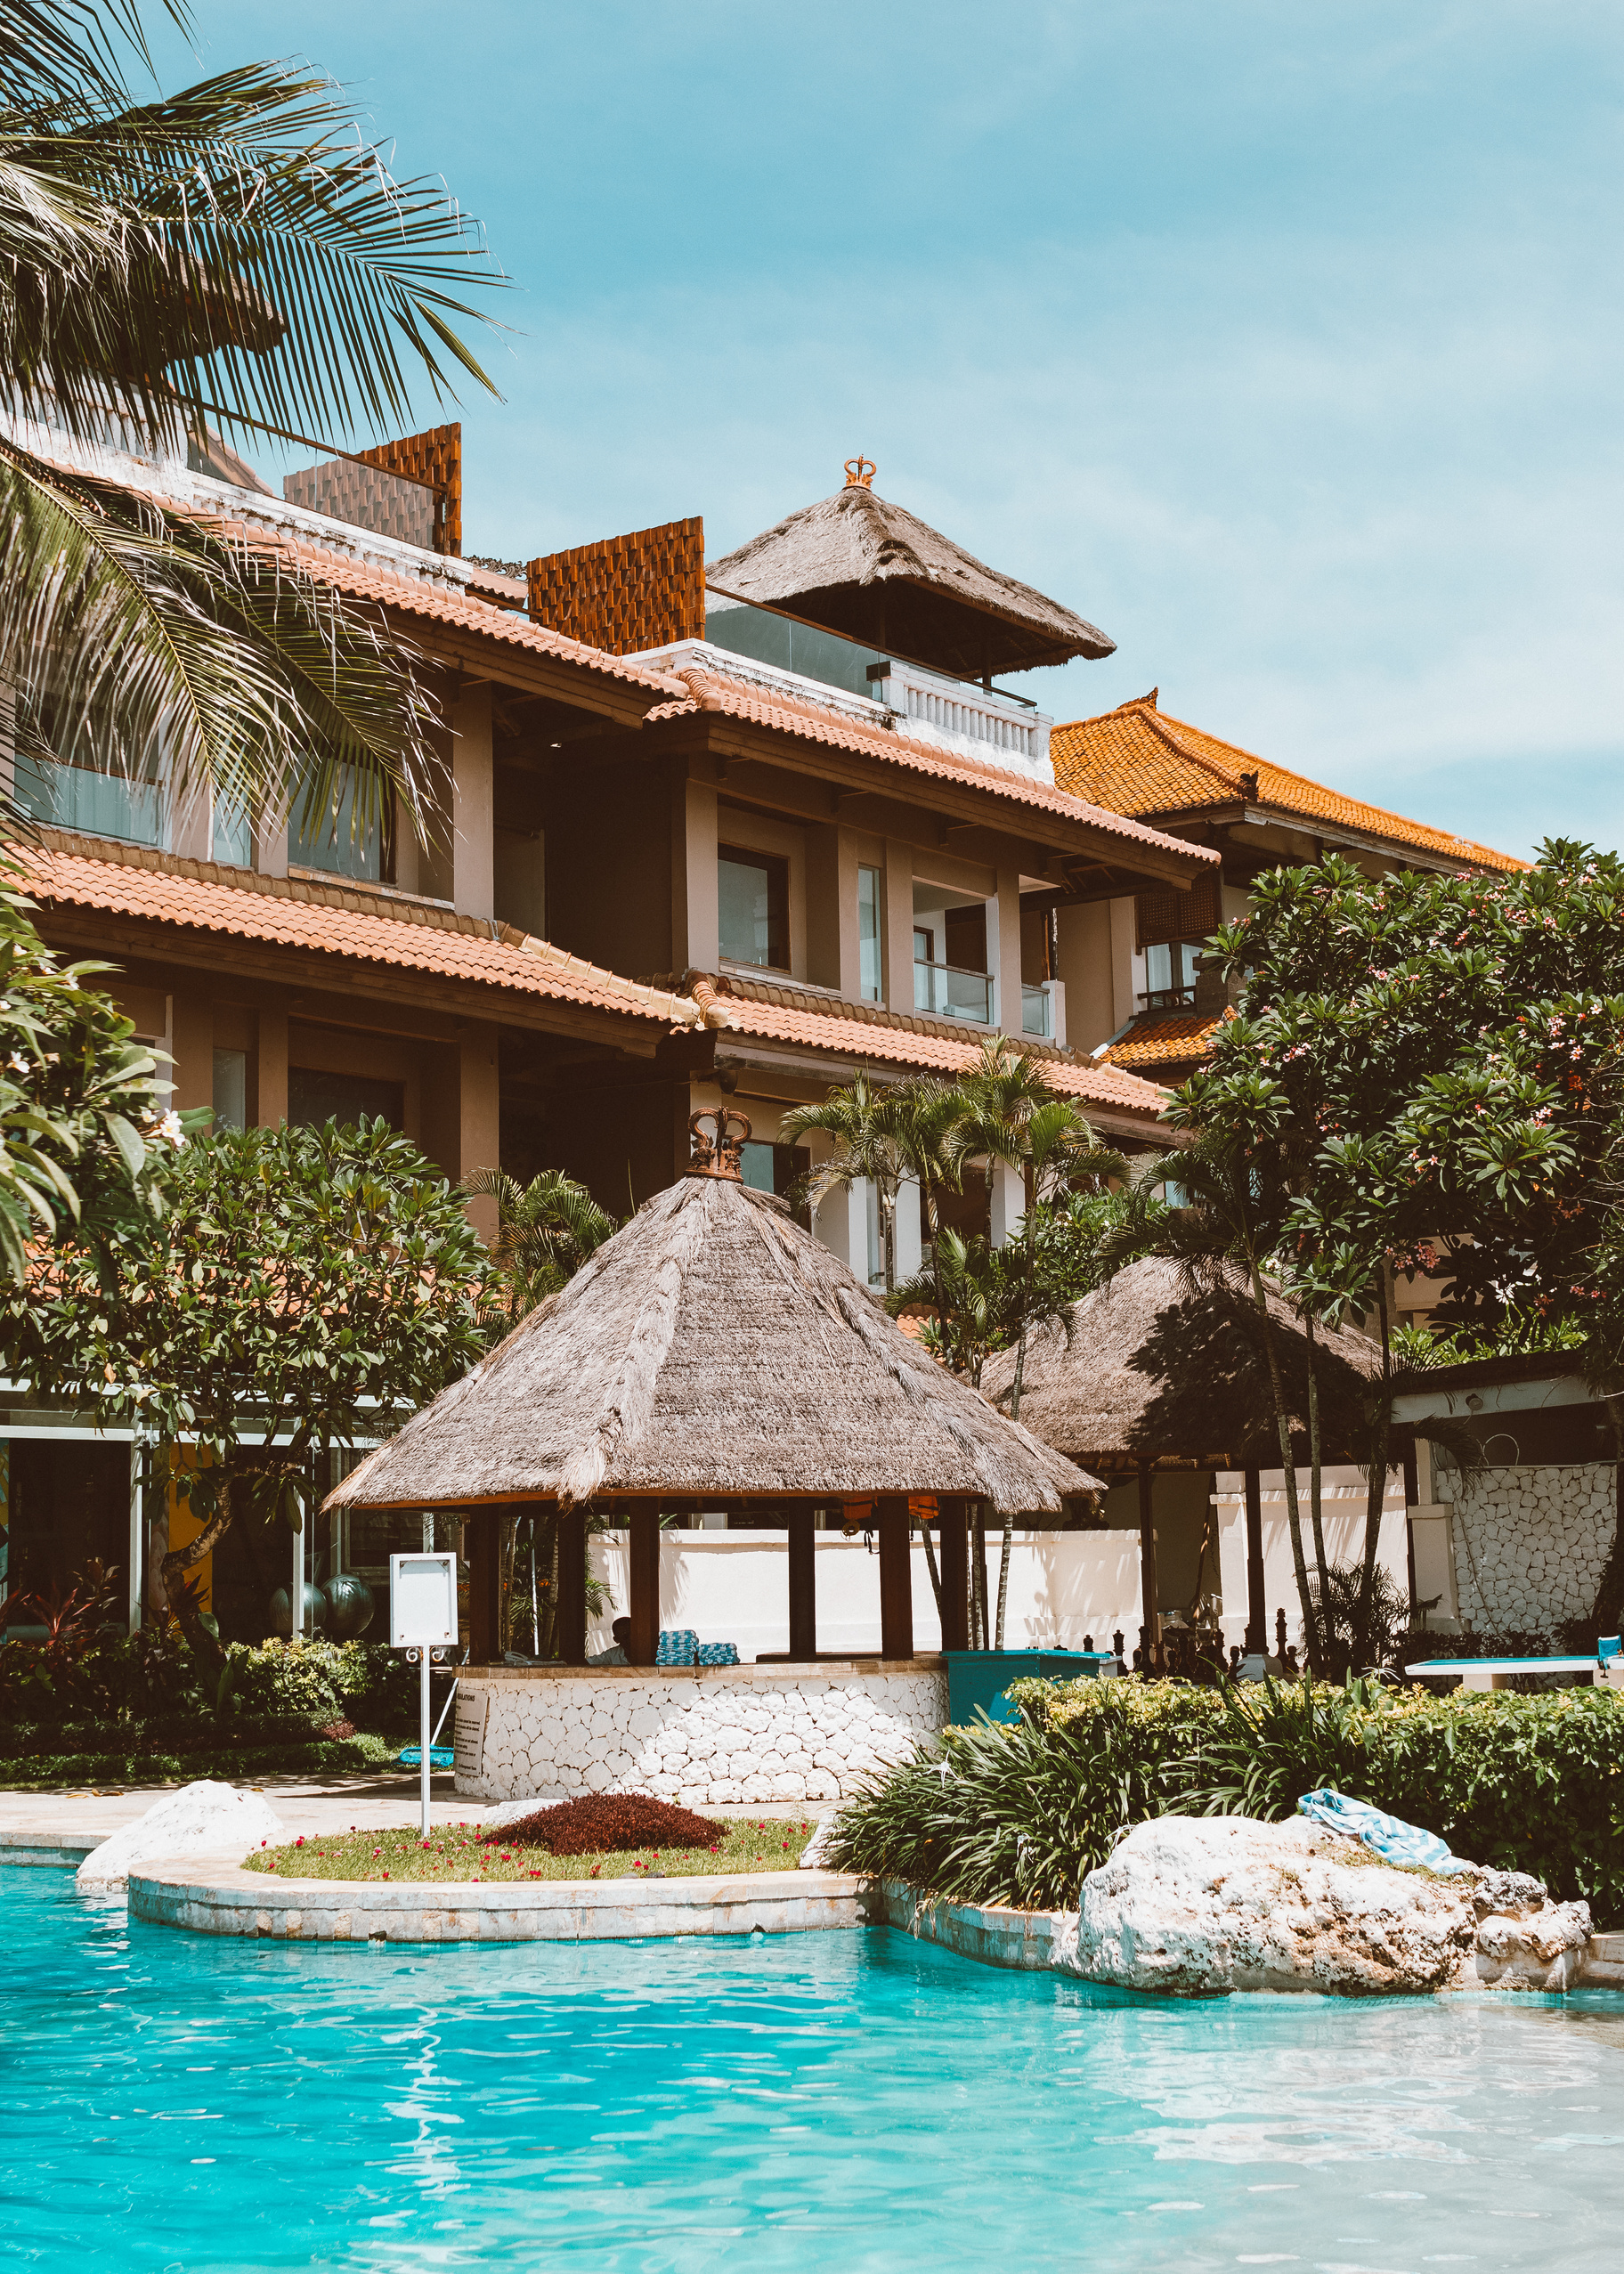
AtliQ
Hospitality Analysis
DIPEAN DASGUPTA
UMIP 4841

Slide 2
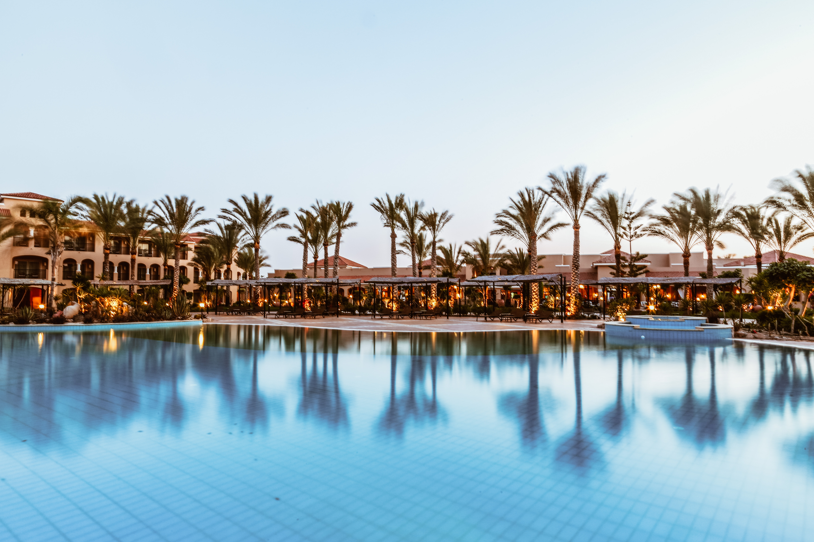
INDEX
01.
INTRODUCTION
04.
DASHBOARD
Table
of Content
02.
DATA OVERVIEW
05.
CONCLUSION
03.
ANALYSIS

Slide 3

Introduction
The AtliQ Hotels Hospitality Analysis Report offers a comprehensive overview of the performance and guest experience across AtliQ Hotels' properties. Covering key metrics from occupancy rates and revenue trends to customer satisfaction and service quality from recent data, this report aims to identify strengths and areas for improvement. By analyzing data on guest demographics, booking patterns, and feedback, the report provides valuable insights into the factors driving customer loyalty and profitability. This in-depth analysis supports informed decision-making to enhance guest experiences, optimize operations, and position AtliQ Hotels for continued growth in a competitive hospitality market.
01

Slide 4
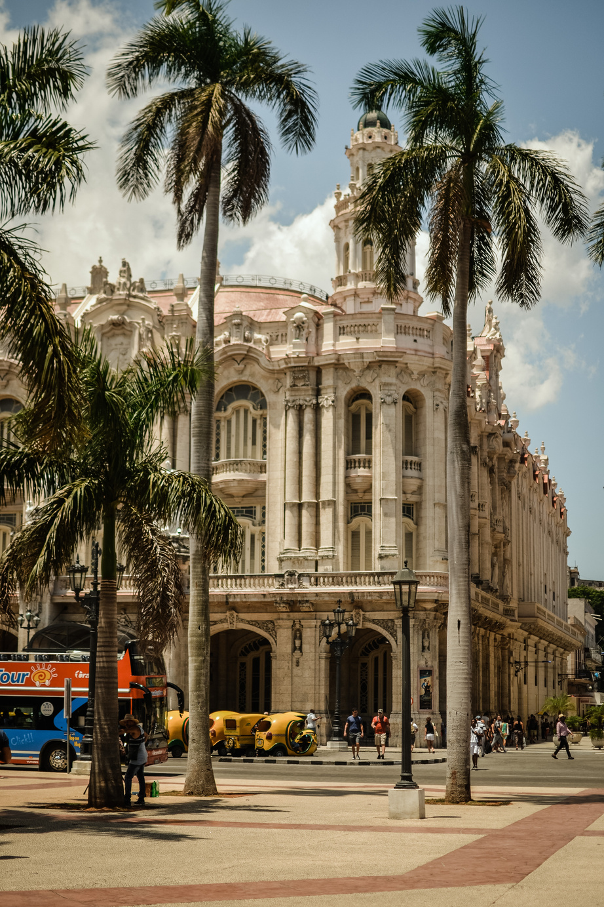
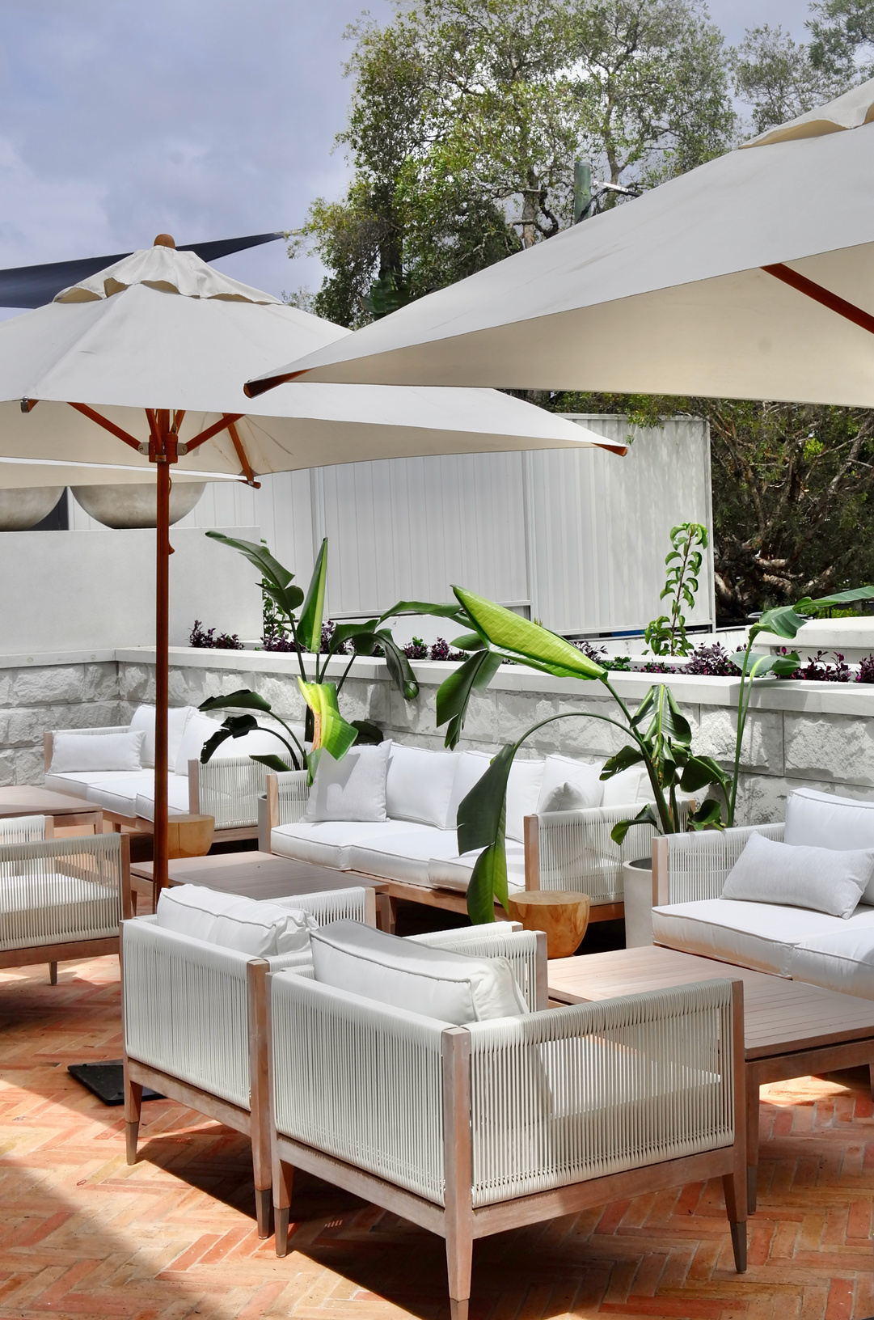
Data Overview
Data : Atliq Hotels Data
Files:Date,Hotels,Rooms,Bookings,AggregatedBooking, metrics_list.
Timespan: May to July 2022.
Total Property: 25
Property category : Luxury, Business
Room Types: Standard, Elite, Premium, Presidential
Cities served: Delhi, Mumbai, Bangalore, Hyderabad.
Total Boookings: 134590.
02

Slide 5
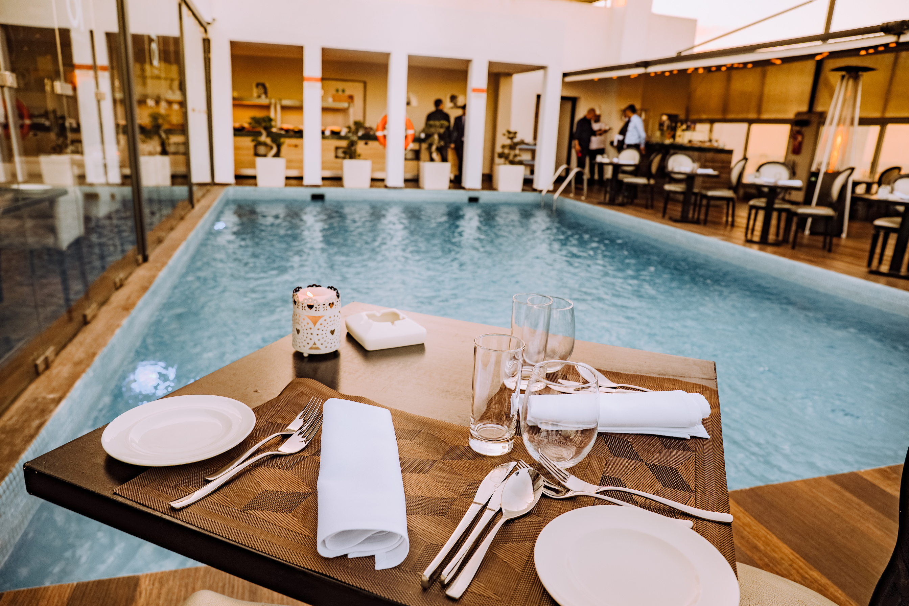
Analysis
General overview
Total Reveneue: INR 1.7 billion
May: 573.2M
June: 564.8M
July: 499.2M
Timespan:May-July 2022
Occupany: 58%
May: 59%
June: 58%
July: 57%
Cancellation Rate: 24.8%
May: 24.8 %
June: 25.1 %
July: 24.4 %
Profit/Loss: INR 298.8Million
May: 99.7M
June: 99.9M
July: 85.2M
Average rating: 3.62
03

Slide 6
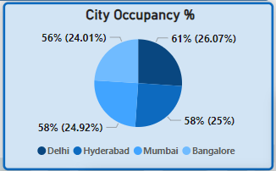
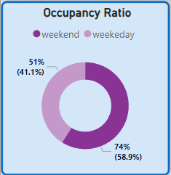
Analysis
Occupancy
In case of occupancy by city, all the 4 cities were almost equally occupied. Delhi, the capital city holds the top position with 26.07% and 61% of AtliQ’s hotels in Delhi were occupied. Hyderabad and Mumbai follows next with equal 25% of share. In this 2 cities, 58% of AtliQ’s hotels were occupied. Banglaore is the last in the list with 24% share and 56% occupancy.
In occupancy ratio, we can see that 58.9% occupancy were was on weekends. It seems quite obvious as weekends are off days for all the working class people and employee. Significant amount of occupancy is also seen in weekdays too with around 41.1%.
04

Slide 7
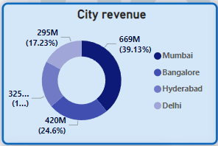
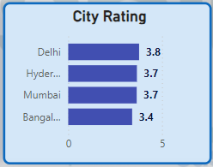
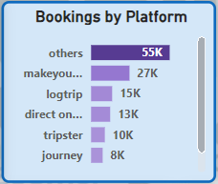
Analysis
Revenue, Rating & Booking
In terms of revenue generated, Mumbai holds the 1st position with around 669M INR. Bangalore and Hyderabad holds the 2nd and 3rd position respectively with 420M and 325M INR. Delhi is the least contributor in revenue generation with around 295M INR only.
City wise, properties of AtliQ got similar ratings. Delhi is the top rated city with score of 3.8 out of 5. Hyderabad and Mumbai scored equal 3.7 out of 5. Rating of Bangalore was the lowest among all with a score of 3.4 out of 5.
In terms of booking, AtliQ’s most of the bookings came through miscellaneous sources which amount to about 55000. Lowest amount of booking were made directly offline mode.
05

Slide 8
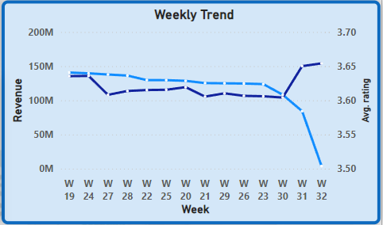
Analysis
Weekly Trend
The weekly trend graph depicts that the revenue of AtliQ has gradually decreased over weeks. In 19th week(May 1st week), revenue was almost 150M INR. From 20th to 28th week, the revenue was between 120M to 135M. It drastically reduced from 30th week. On 31st week, revenue dropped drastically down to 84.2M and in week 32, it decreased much more to just 3.9M only.
In these timespan, weekly average rating was in between 3.6 and 3.7. Ratings in first few weeks decreased but at the last 3 weeks , it increased sharply.
06

Slide 9
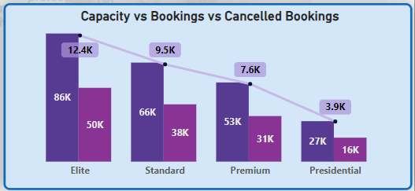
Analysis
Capacity vs Bookings vs Cancelled Bookings
In the hotels of AtliQ, for the Elite class against capacity of 86K bookings were 50K and cancellation were around 12.4K. In standard class against capacity of 66K, bookings were 38K with cancellation of 9.5K. In Premium category, against capacity of 53K, bookings were 31K only with cancellation of 7.6K. In presidential category, against capacity of 27K, bookings were 16K only with around 3.9K cancellation.
07

Slide 10
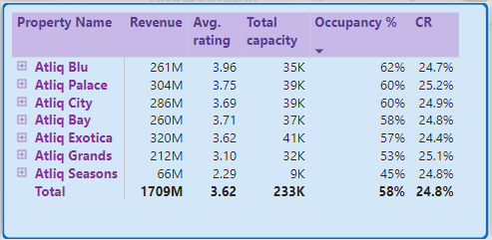
Analysis
Property Analysis
Here details on the top properties of AtliQ are shared.
08

Slide 11




Thank You for Watching
DIPEAN DASGUPTA
+91 7778992530
dipeandasgupta@gmail.com
https://github.com/DipeanDas/UM_InternshipProjects/tree/main/AtliqHospitalityAnalysis
Gandhinagar,Gujarat

